Slide 1
Asthma and Air Quality
Analysis by Aaron Kerestes

Slide 2
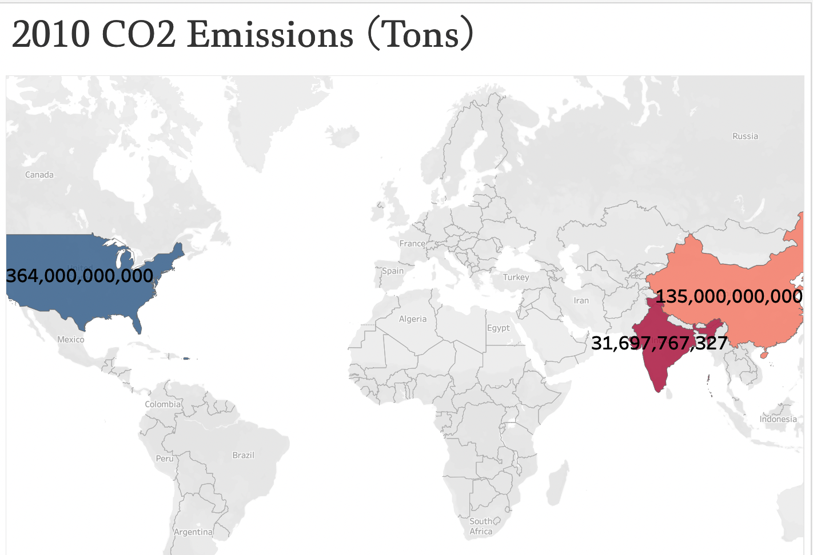
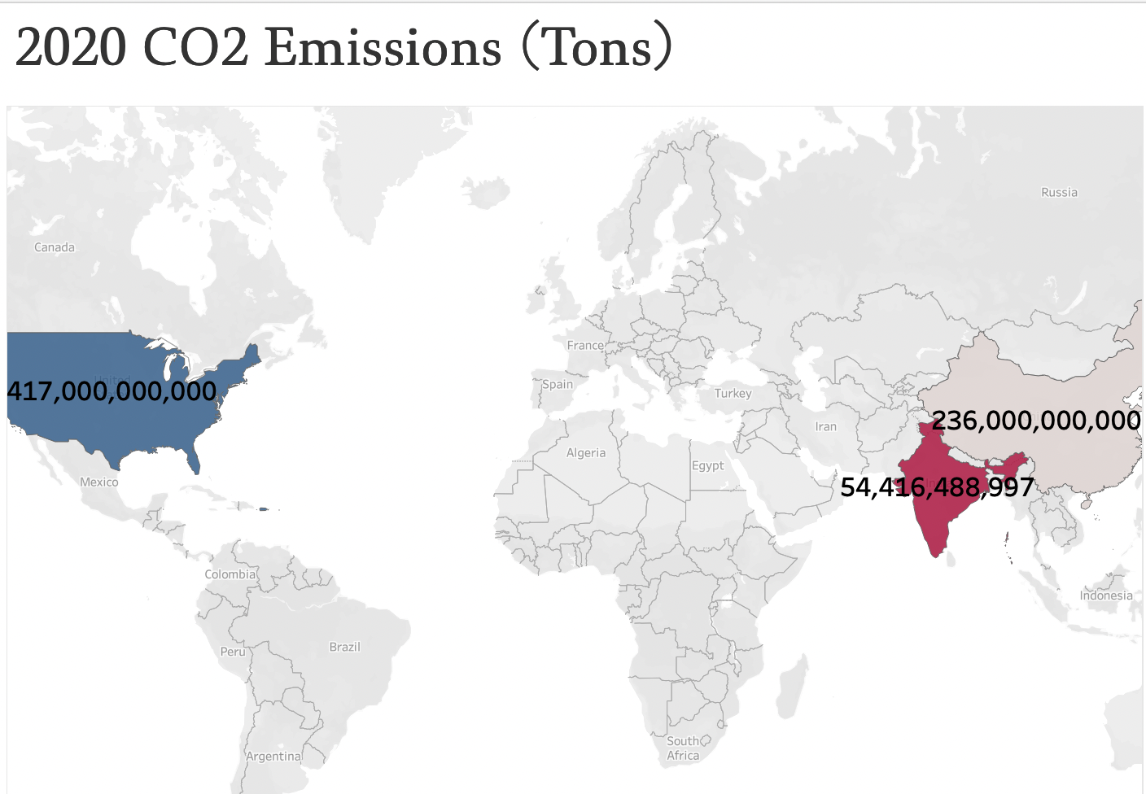
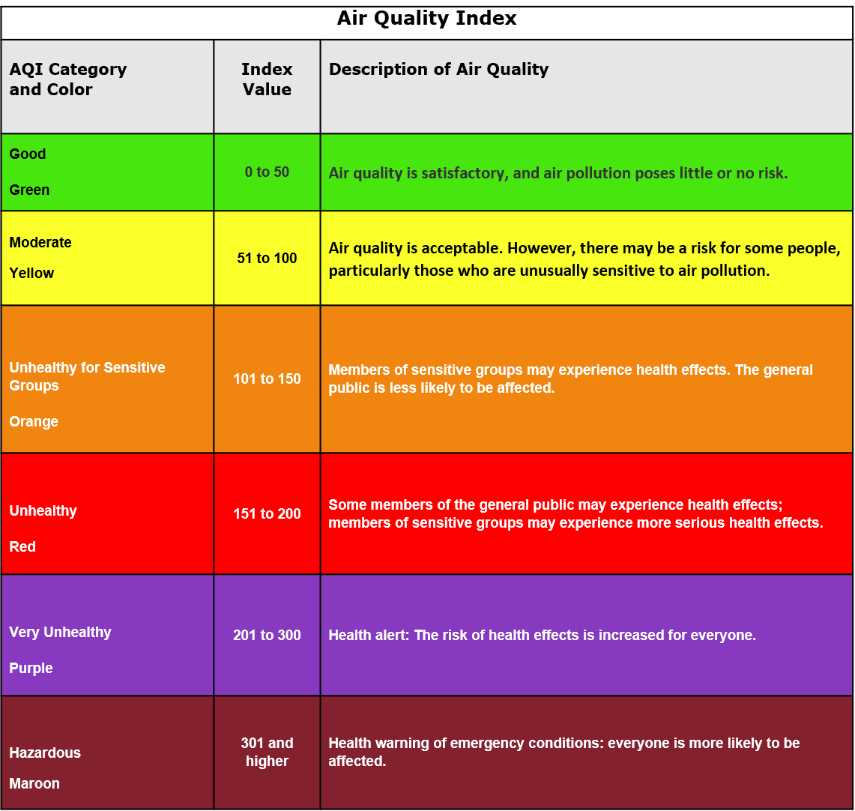
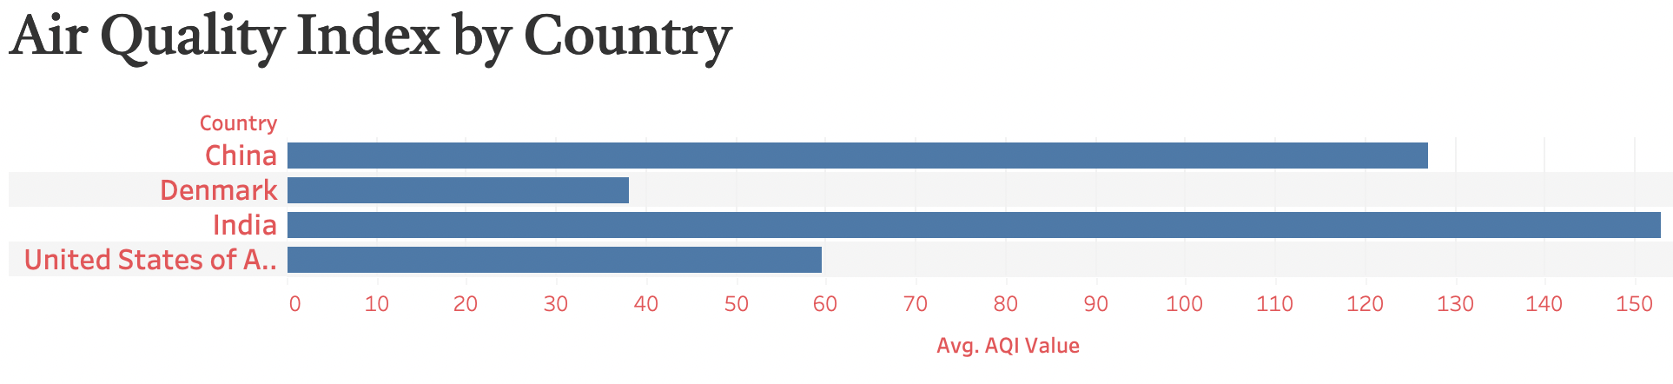
Air Quality Among the 3 highest CO2 emitters
Air Quality Index averages at “Unhealthy for Sensitive Groups” in China and India
US AQI averages at “Moderate” even with higher emissions
Likely due technological advances and sustainable practices among corporations
Denmark included to show differences between AQI among countries

Slide 3
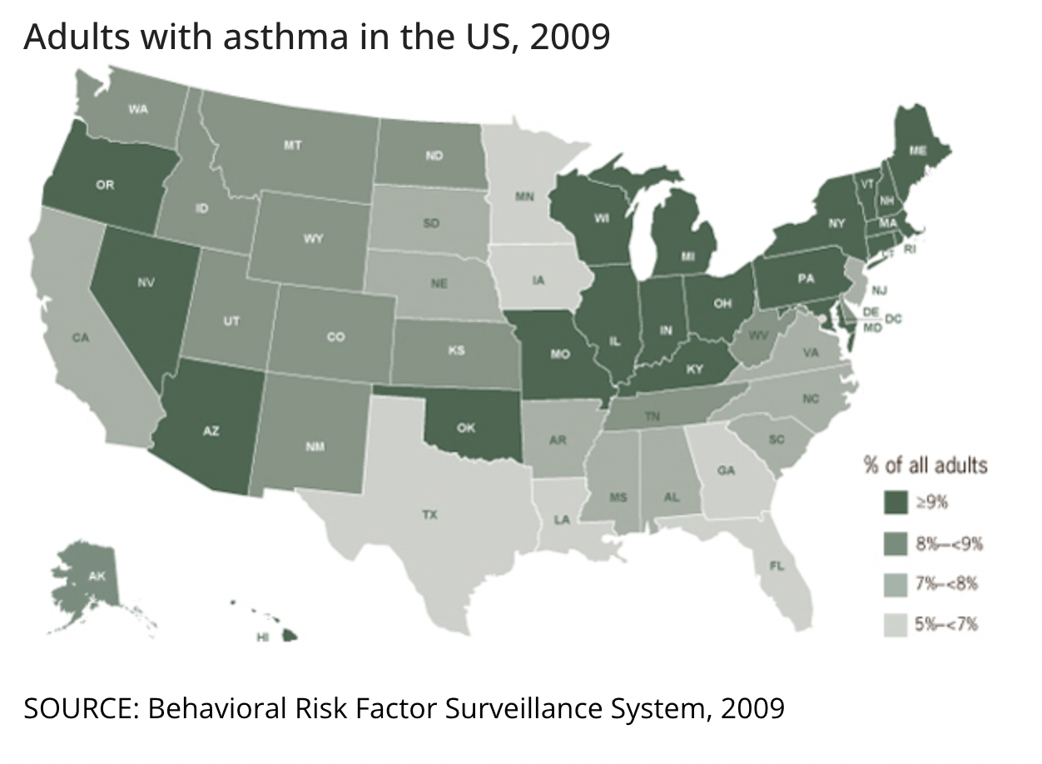
Source: Center for Disease Control
Asthma affects 1 of every 11 people
Data from State of California
Conservative indicator, low asthma rates compared to other states (National Average >7%)

Slide 4
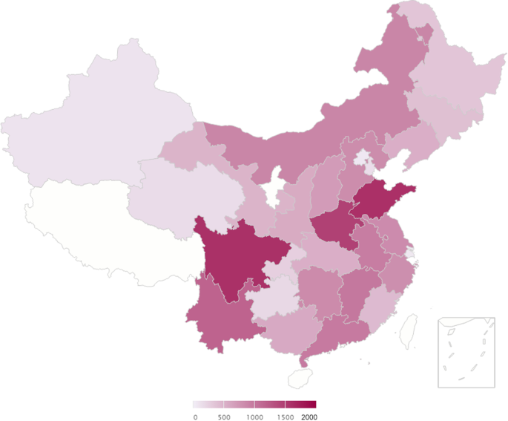
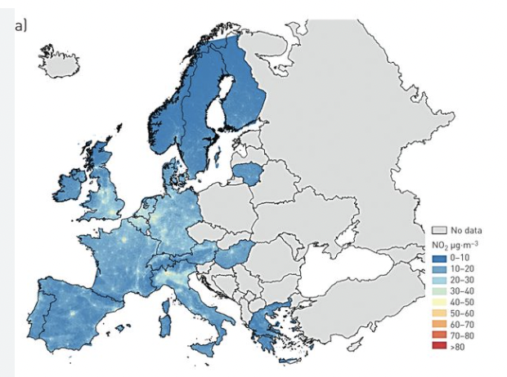
Asthma Rates
Source: BMC Pulmonary Medicine
Source: European Respiratory Journal
Prevalence of asthma in Chinese adults is ~4.5%
Prevalence of asthma in Denmark is ~3.6%

Slide 5
Conclusion
Asthma rates in adults are higher in countries with more emissions
Countries like Denmark have lower rates as they have lower CO2 emissions
Air Quality Index can cause more respiratory issues and increase rates of Asthma

Slide 6
Recommendations
Increase asthma awareness and education on how to identify symptoms, where to be treated, how to minimize respiratory issues
Move towards cleaner, alternative energy; drive technological advances to reduce emissions from combustion & fossil fuels
Increase availability of medication for impoverished communities where it may be more difficult to get help or medicine

Slide 7
Thank You!

